Slide 1

Data Analysis of Box Office Trends (2017)
Dash Gomez, Cintia de Castro,Cinthya Gomez, Bryan Reyes

Slide 2
AGENDA
Introduction
Executive Summary
Context
Methodology, Visuals & Conclusion

Slide 3

Client: Warner Bros. executives
Data Source: External data obtained by us, data analytics team, including:
Data Breakdown:
Movie Title/Cast/Director
Date of release (2012 through 2016)
Total of 508 movies
Budget, box office revenue, profit
INTRODUCTION
Notes:
Dash

Slide 4
Client issue: Warner Bros. executives are interested in learning about past trends in the industry to plan the production of their next blockbuster.
Objective: Provide recommendations on creating a profitable live action film based on data analysis of movie box office performance.
Key Findings:
Top months to release: June & July
Top genres: Action & Sci-Fi
Top director among Action & Sci-fi: Tim Miller
Top actor in leading genre (Action): Ryan Reynolds
EXECUTIVE SUMMARY
Notes:
Cintia

Slide 5
CONTEXT
This project is important for several reasons:
Financial Impact: enhance profit and minimize loss
Competitive Advantage: insights make us more competitive
Risk Mitigation: trends & patterns
Notes:
(Cintia) Financial Impact: It takes box office revenue into account, which helps us make informed decisions that maximize profit and minimize loss.
Competitive Advantage: Our analysis looks into the variables that most impact profit: month in which a movie is released, and director, cast, and genre choice. This way, we can gain insight into what makes Warner Bros. most competitive in the industry.
Risk Mitigation: By analyzing historical data in the movie industry, we can have a clearer vision of possible trends and patterns. With this, we hope to reduce the risk of financial loss associated with film production and marketing efforts.

Slide 6

METHODOLOGY
Data Processing and selection: Cleaned and filtered the data, removed the animations films, and removed the data set of films that did not bring in profit.
Measurement of Success: Our key metrics for success is Profit (Box office revenue - Budget)
Data Analysed: There were a total of 508 movies, out of which 392 were considered for this analysis. Variables include month of release, leading cast, main director, budget, box office revenue, profit, and genre.
Notes:
Bryan

Slide 7
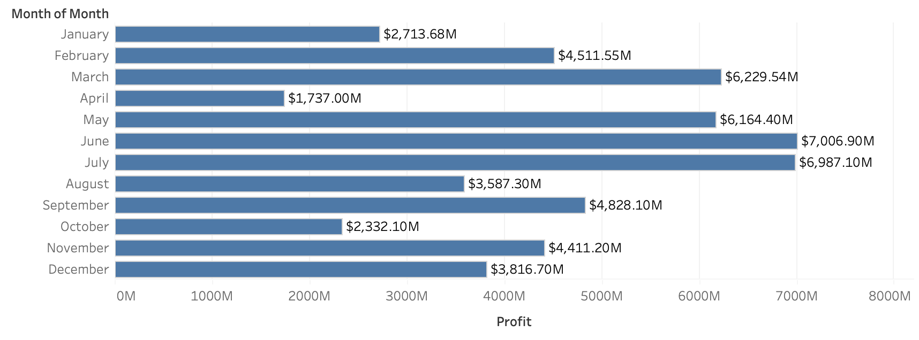
Box Office Profit by Month
Findings:
June and July are the most profitable months
By breaking down total Box Office Revenue Profits by month, we are best able to assess the ideal release date for our future film project.
Notes:
Dash

Slide 8
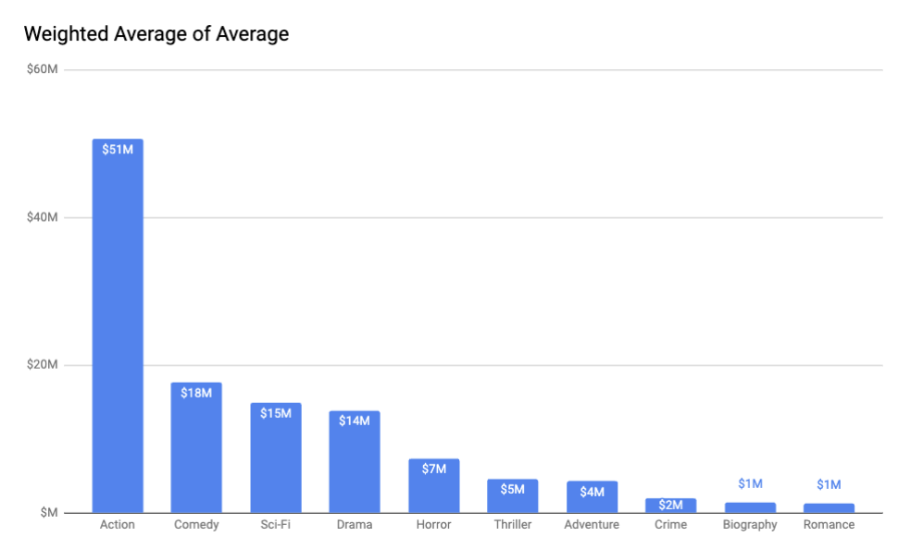
Top Grossing Genres
WEIGHTED AVERAGE
Weighting the average accounts for genre profitability variations
Action is top grossing Genre
Total Earnings/Gross Income vs ROI
Notes:
Cinthya:

Slide 9
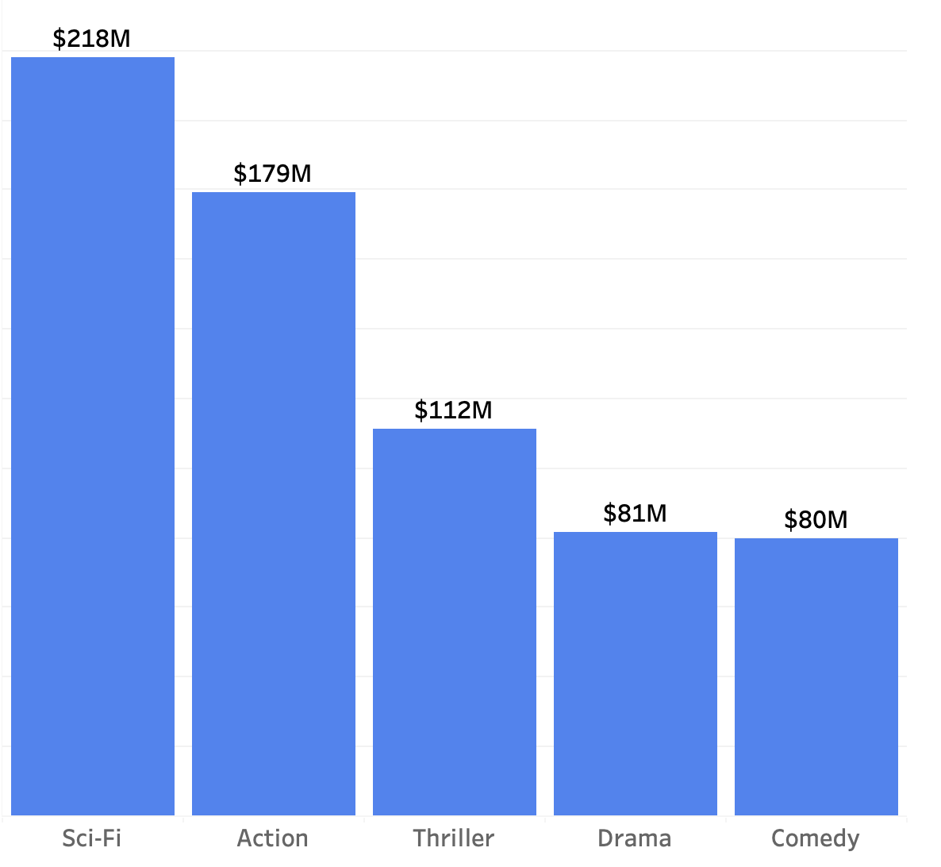
Average of profit
Sci-fi is the top grossing genre
The Hunger Games: Mockingjay 1 & 2
AVERAGE OF PROFIT

Slide 10
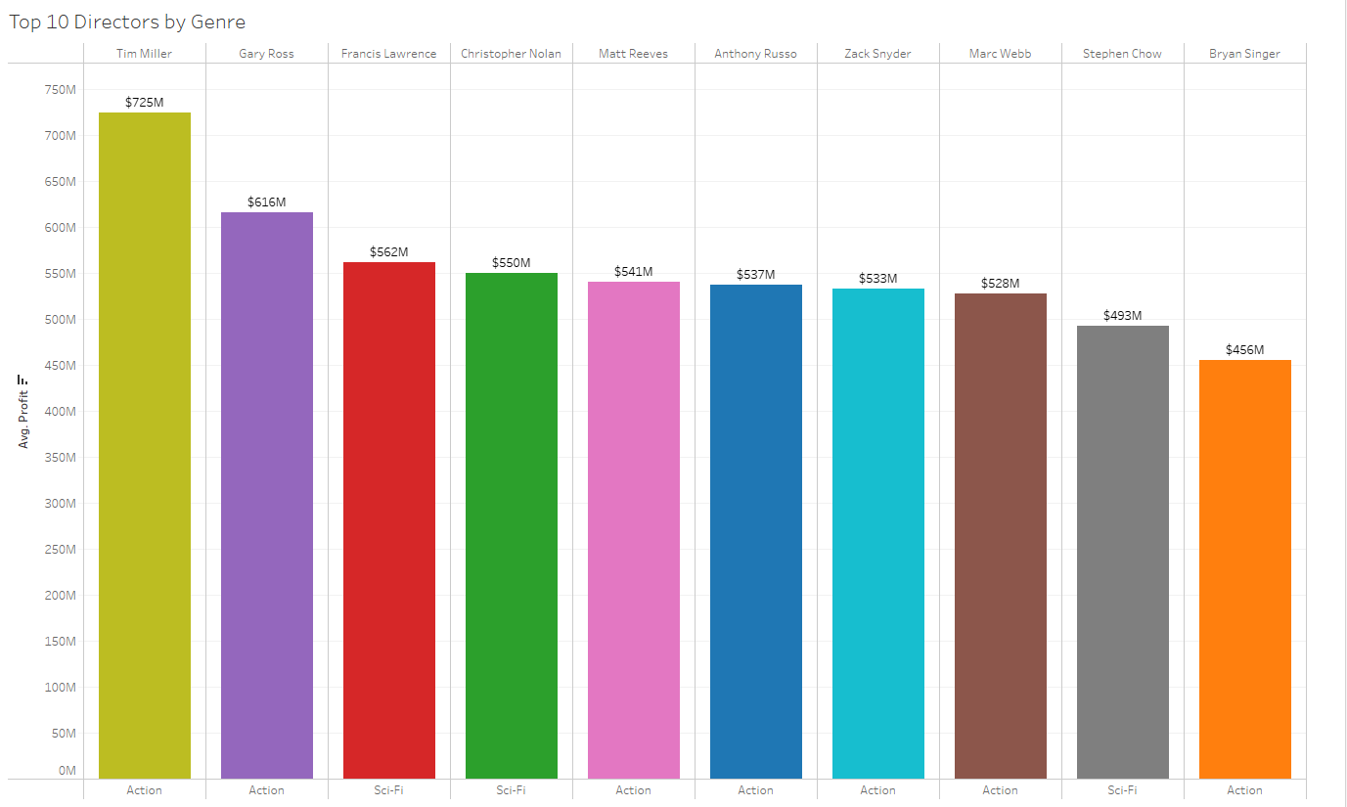
TOP 10 DIRECTORS
Average Profit made
Include only action and Sci-Fi
Highest-grossing director Tim Miller
Notes:
Bryan: Top 10 directors
When there's a need for a chart, make a copy of the Google sheets from step 1 of this slide.
Save that document in the same place as the slide deck you are working from. Even better if slide decks that need charts have their own folder within Google drive so that it appears as a “packaged” set.
From there, open up the Google sheets and edit the data for the chart(s) you need.
Now, all you have to do is copy/paste the graphs into your slide deck. There is also the option of inserting a chart from a Google sheets within Google slides (insert > chart > from sheets) but I think the former is easier.
The above is simplified as “Step 1” on this slide. This will also be documented in a FAQ document for this slide template (new idea: If it’s helpful, I could also make a screen recording of this process for visual learners). Step 2 and 3 of this slide are to ensure consistency with our chart titles and legends. If these were to be made within excel, it would resize with the chart like an image, making it difficult to keep the text size the same from chart to chart.
The following slides are examples to help the team visualize how to place graphs within a slide. These charts are unlinked because we don’t want anyone directly editing the master Google sheets template, but when they create their own charts, I recommend maintaining the link so they can go back and edit the data (once unlinked, the chart becomes an image).

Slide 11
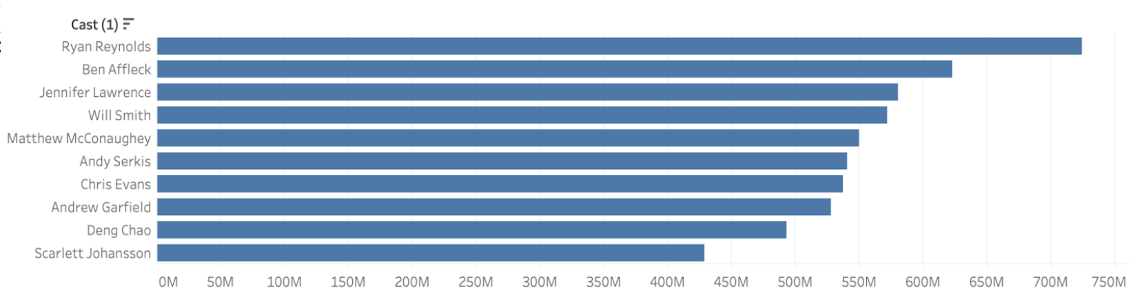
Top Performing Actors in Action and Sci-Fi
Cast: Ryan Reynolds as the lead, Ben Affleck and Jennifer Lawrence as co-leads.
Notes:
Cintia- based on our data, we can say that a movie with the trifecta of leading actors in those genres are RR, BA, and JL.
On the left, we can see the top 10 actors between 2012 and 2016. Below, we see the amount in millions that the movies these actors worked in generated as profit.

Slide 12
CONCLUSION
KEY RECOMMENDATIONS
Movie release should be mid-June to capitalize on the June and July peak and avoid the August downturn
Tim Miller’s impressive average profit and chemistry with Ryan Reynolds makes them a compelling choice for our film
Leading actor should be Ryan Reynolds, with Jennifer Lawrence and Ben Affleck as co-stars
Genre should be Action with Sci-Fi aspects
Notes:
In summary, the data-driven insights we've presented offer a clear roadmap for Warner Bros. Studios' future initiatives. By strategically coordinating our release calendar with the favorable months of June and July, forging collaborations with the high-grossing director Tim Miller, harnessing the magnetic appeal of Ryan Reynolds, and giving priority to the Action genre, we can significantly enhance our prospects of crafting blockbuster hits and securing financial prosperity.
We firmly believe that putting these recommendations into action will not only bolster our standing in the film industry but also contribute to the creation of memorable and lucrative cinematic experiences for our audiences. We eagerly anticipate the opportunity to collaborate and shape the future of Warner Bros. Studios, committed to consistently delivering outstanding entertainment worldwide. We extend our gratitude for your attention and consideration.
Call to action: Audience Engagement: Choosing variables strategically allows us to cater movies to our target audience. This can lead to higher engagement and satisfaction among moviegoers.

Slide 13


Fin

